Slide 1

Investigate Business Hotel using Data Visualization
Created by:
Philipus Dima Wira Pratomo
pwirapratomo@gmail.com
https://www.linkedin.com/in/philipus-dima-wira-pratomo-a221391ab/
Graduated from Pertamina University majoring in petroleum engineering with a GPA of 3.78. Currently I want to shift career to data scientist by attending a data science bootcamp. where I am developing expertise using data visualization tools such as Tableau and Looker Studio, SQL and several Python libraries to create machine learning. My objective is to become a professional data scientist and leverage my skills to contribute to data-driven decision-making in diverse industries.

Slide 2
Overview
It is crucial for a company to consistently analyze its business performance. In this instance, we will delve deeper into the hospitality industry. Our focus is to understand the customer behavior in hotel reservations and its correlation with the cancellation rate. The insights gained will be presented in the form of data visualizations for better comprehension and enhanced persuasiveness
For more details, please refer to the Jupyter notebook here

Slide 3
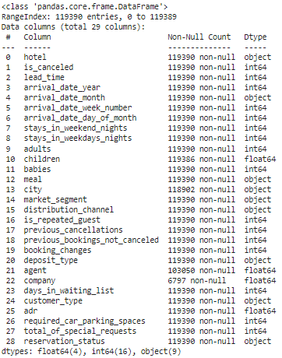
Dataset
Description
Dataset contains customer behavior features who made hotel bookings
Shape
Dataset have 119,390 records and 29 feature
Dtype
Float64 (4 features), int64 (16 features), object (9 features)
For more details, please refer to the Jupyter notebook here

Slide 4
Data Preprocessing
Checking Data Type
Feature Children,agent dan company could change into Integer
Checking Missing Value
There are several null data that need to be addressed in the features: company, agent, city, and children.
Checking Inappropriate Values
There is an "undefined" value in the meal feature that is not appropriate.
Checking Unnecessary Data
There is an inaccurate data value, where Adults = 0.
There is an inappropriate data value for stays_in_weekend_nights = 0 and stays_in_weekdays_nights = 0 as well.
The feature adr, Average Daily Rate (room revenue/number of rooms sold), contains negative values.
Checking Duplicate Value
There are 33261 duplicate data
For more details, please refer to the Jupyter notebook here

Slide 5
Data Preprocessing
Handling Missing Value
Data containing null values will be filled with zeros, indicating:
company: guests who are not affiliated with any company
agent: guests who make reservations without going through an agent
children: guests who do not bring any children
2. For the 'City' attribute, null values will be replaced with 'unknown' since the exact city is not known.
Handling Data Type
The features "Children," "Agent," and "Company" can be converted to integers, as their data appears to be representable with integer values.
Replace inappropriate values
Modify 'Undefined' in the 'meal' category to 'no meal' since it represents the same data.
Handling Duplicate Values
Data without a unique_id/unique_booking_id and date may contain information resulting from the same reservation at different times.
Discard Unnecessary data
The data value for Adults is set at 0, indicating that it is not possible without adults.
A new feature, stay_duration (calculated as stays_in_weekend_nights + stays_in_weekdays_nights), represents the total duration of stay. Instances where stay_duration is 0 will be excluded.
The adr (Average Daily Rate), calculated as room revenue divided by the number of rooms sold, contains negative values due to sales data.
For more details, please refer to the Jupyter notebook here

Slide 6
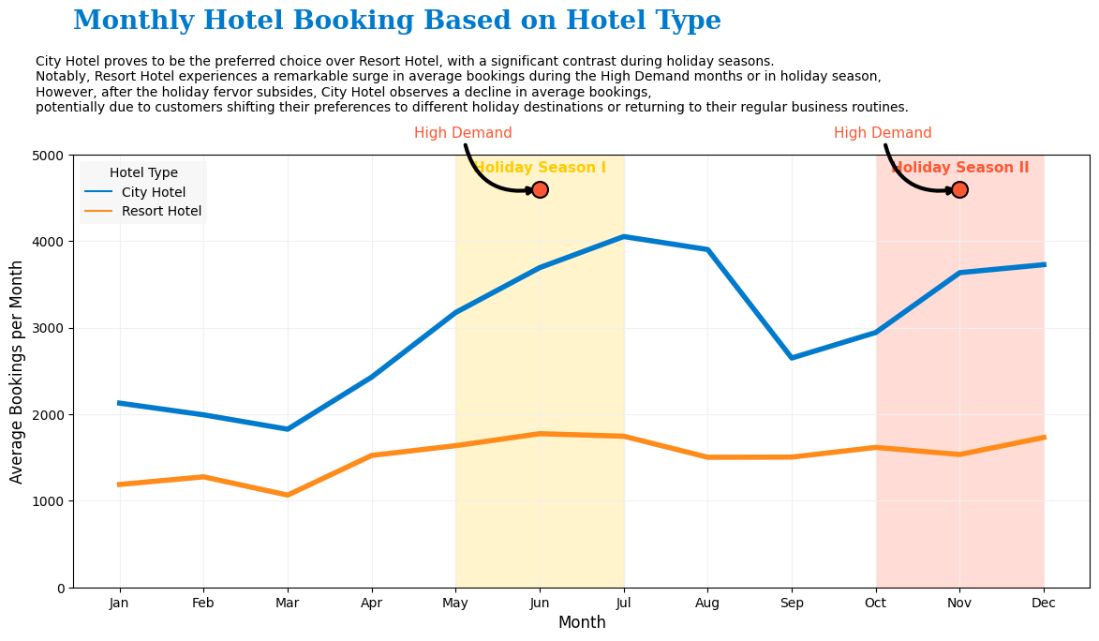
Monthly Hotel Booking Analysis Based on Hotel Type
For more details, please refer to the Jupyter notebook here

Slide 7
Monthly Hotel Booking Analysis Based on Hotel Type
Insight :
Overall, City Hotels are generally more preferred than Resort Hotels.
Broadly speaking, Resort Hotels exhibit a more stable monthly booking average compared to City Hotels, which show significant variations during the Holiday Season.
There is an increase in the average booking rates during the High Demand months or holiday seasons in Indonesia, namely the mid-year period (May to July) and the year-end period (October to December).
Following the holiday season, a decline in average booking rates is observed for City Hotels.
For more details, please refer to the Jupyter notebook here

Slide 8
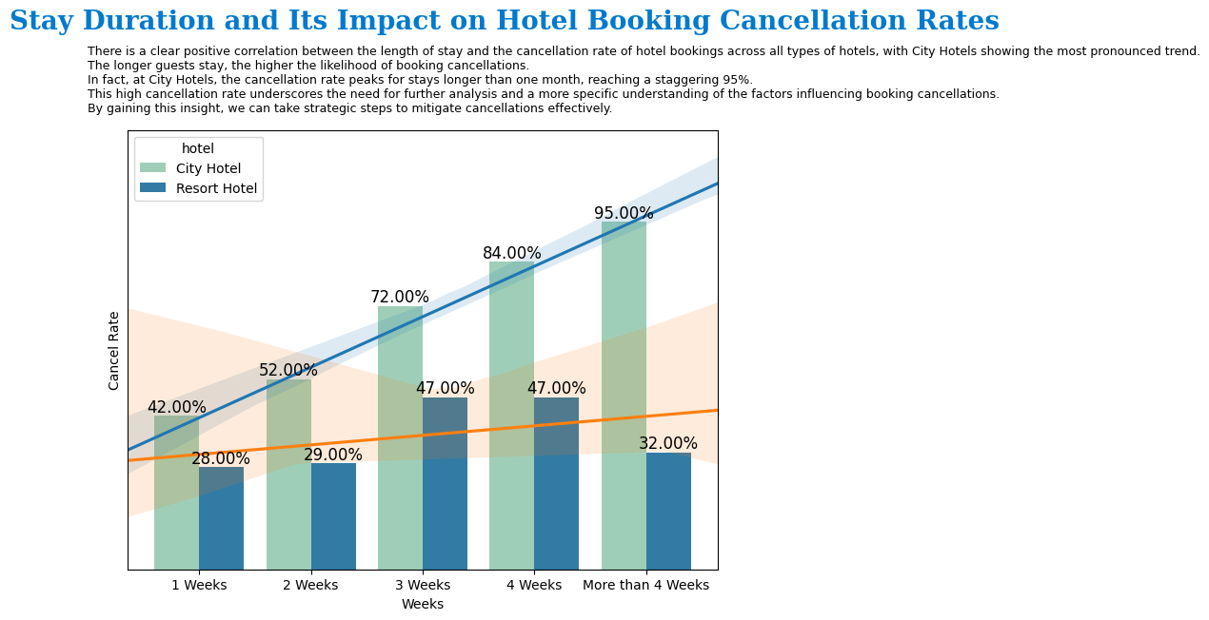
Impact Analysis of Stay Duration on Hotel Bookings Cancellation Rates
For more details, please refer to the Jupyter notebook here

Slide 9
Impact Analysis of Stay Duration on Hotel Bookings Cancellation Rates
INSIGHT :
There is a positive correlation between the duration of stay and the cancellation rate for all types of hotels, with the most noticeable impact observed in City Hotels.
The longer the duration of stay, the higher the cancellation rate for hotel reservations.
In City Hotels, the highest cancellation rate is observed for stays exceeding one month, reaching 95%.
The cancellation rate is quite high, necessitating further analysis and a more specific examination of relationships to mitigate cancellations effectively.
For more details, please refer to the Jupyter notebook here

Slide 10
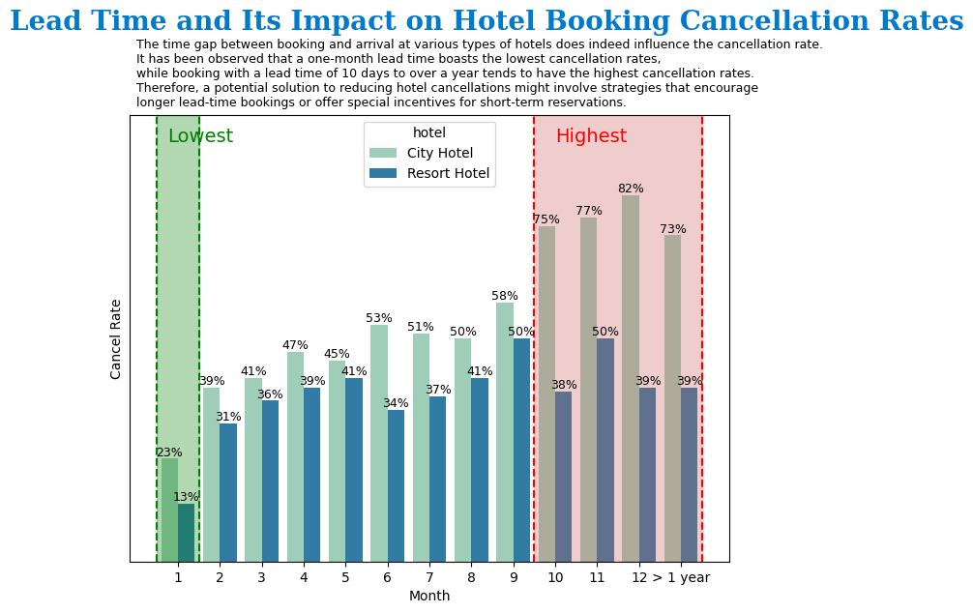
Impact Analysis of Lead Time on Hotel Bookings Cancellation Rate
For more details, please refer to the Jupyter notebook here

Slide 11
Impact Analysis of Lead Time on Hotel Bookings Cancellation Rate
INSIGHT :
The time interval between booking and arrival significantly influences the cancellation rate for each type of hotel.
A one-month lead time has the lowest cancellation rate, approximately 20% for each hotel.
The time interval of 10 months to over a year exhibits the highest cancellation rate.
For more details, please refer to the Jupyter notebook here

